Slide 1


3D Graphics & Animation
Workshop 1

Slide 2
vector
A vector has magnitude (size) and direction
magnitude

Slide 3
Representing vector
Using two numbers e.g. (3,4) in a 2D space
0 1 2 3 4 5 6 7 8
0 1 2 3 4 5 6 7 8 9 10

Slide 4
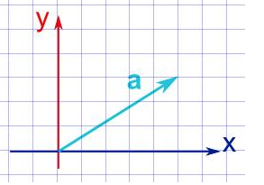
Quiz
What is the vector a ?

Slide 5

Length of a vector
v = (3,4)
|v| = sqrt(3² + 4²)
= 5
0 1 2 3 4 5 6 7 8
5
0 1 2 3 4 5 6 7 8 9 10

Slide 6
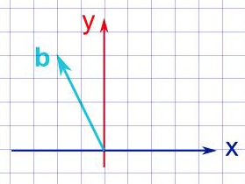
Quiz
What is the length of b ?

Slide 7

Vector normalisation
Transform the vector to a unit vector
Unit vector has a length of 1
v = (3,4)
|v| = 5
norm v = (3/5 , 4/5)
= (0.6,0.8)
Length of (0.6,0.8)
= sqrt(0.6² + 0.8²) = 1
0 .2 .4 .6 .8 1 1.2 1.4 1.6
1
0 .2 .4 .6 .8 1 1.2 1.4 1.6 1.8 2

Slide 8
Quiz
Work the unit vector of a.

Slide 9

Multiplication by a scalar
A scalar is a single number
a = 5
v = (3,4)
av = (5x3,5x4) = (15,20)
0 5 10 15 20 25 30 35 40
0 5 10 15 20 25 30 35 40 45 50

Slide 10

Negating a vector
Change the direction of a vector
v = (3,4)
-v = (-3,-4)
-4 -3 -2 -1 0 1 2 3 4
-3 -2 -1 0 1 2 3 4 5 6 7

Slide 11


adding vector
You can add two vectors by simply joining them head-to-tail:
And it doesn't matter which order you add them, you get the same result:

Slide 12
Adding vectors
vector A (3,4) add vector B,(5,3)
0 1 2 3 4 5 6 7 8
0 1 2 3 4 5 6 7 8 9 10

Slide 13
Adding vectors
vector A (3,4) add vector B,(5,3)
New x is 3 + 5 = 8
New Y is 4 + 3 = 7
0 1 2 3 4 5 6 7 8
0 1 2 3 4 5 6 7 8 9 10

Slide 14
Adding vectors
vector A (3,4) add vector B,(5,3)
The new resultant vector
is (8,7)
0 1 2 3 4 5 6 7 8
0 1 2 3 4 5 6 7 8 9 10

Slide 15
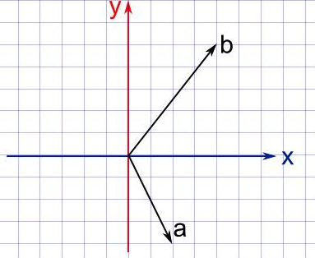
Quiz
Work out a + b
a+b = ((2+4)+(-4+5))
= (6,1)

Slide 16
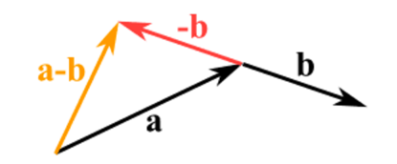
Subtract vector
Reverse the direction of the vector we want to subtract,
Then add them as usual:
E.g. (5,3) – (3,4)
= (5,3) + (-3,-4)
= (5-3 , 3-4)
= (2,-1)
Note: Subtraction of vector is NOT COMMUNICATIVE
That is a – b != b - a

Slide 17
Quiz
Work out a - b
a=(2,-4)
b=(4,5)
a-b=((2-4),(-4-5))
=(-2,-9)

Slide 18
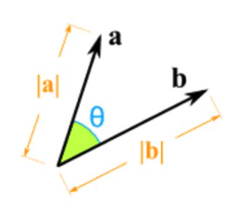
Dot Product
a· b = ax ×bx +ay ×by
Result will be a scalar
a = (3,4)
b = (5,6)
a.b = 3x5 + 4*6 = 15+24 = 39
Also a · b = |a| × |b| × cos(θ)
Use dot product result to find the angle between two vectors.

Slide 19
Quiz
If a = (3,4,-1) and b = (-2,1,2)
Work out a.b
a.b = (3*-2)+ (4*1)+(-1*2)
= -6+4-2
= -4

Slide 20
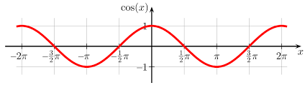



Dot Product
a · b = |a| × |b| × cos(θ)
$\cos{θ=\frac{a.b}{\left|a\right|\left|b\right|}}$
If a and b are both unit vector, |a| and |b| are 1.
$\cos{θ=a.b}$ (Note: $θ$ is the angle between a and b)
If $θ$ is zero
$\cos{θ=a.b}$ = 1
If $θ$ is 90º(PI/2)
$\cos{θ=a.b}$ = 0
$cos⁡(θ$)
$$θ$$

Slide 21
Quiz
When is a.b = -1 ?
When angle is 0
When angle is n𝝿
When angle is 2n𝝿
When angle is (2n-1)𝝿
Where n is an integer

Slide 22
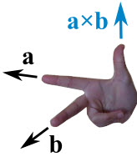
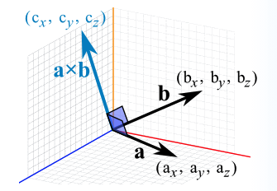
Cross Product
Only works for 3D space (x,y,z)
The result will be a vector which is
Perpendicular to both vectors
Direction is determined by right-hand-rule
If a and b start at the origin point (0,0,0),
the Cross Product will end at:
c_{x} = a_{y}b_{z} − a_{z}b_{y}
c_{y} = a_{z}b_{x} − a_{x}b_{z}
c_{z} = a_{x}b_{y} − a_{y}b_{x}

Slide 23
Cross Product
Assume a = (2,3,4) and b = (5,6,7)
The cross product of a x b is
c_{x} = a_{y}b_{z} − a_{z}b_{y} = 3×7 − 4×6 = −3
c_{y} = a_{z}b_{x} − a_{x}b_{z} = 4×5 − 2×7 = 6
c_{z} = a_{x}b_{y} − a_{y}b_{x} = 2×6 − 3×5 = −3
Answer: a × b = (−3,6,−3)

Slide 24
Quiz
If a = (3,4,-1) and b = (-2,1,2)
Work out a x b
c_{x} = (4*2)-(-1*1)
= 9
c_{y} = (-1*-2)-(3*2)
= -4
c_{z} = (3*1)-(4*-2)
= 11
a x b = (9,-4,11)

Slide 25
Quiz
If a = (-2, 1, 1), b = (2, 1, 1) and c = a × b,
What is the magnitude of c?
c_{x} = a_{y}b_{z} − a_{z}b_{y} = (1*1)-(1*1) = 0
c_{y} = a_{z}b_{x} − a_{x}b_{z} = (1*2) − (-2*1) = 4
c_{z} = a_{x}b_{y} − a_{y}b_{x} = (-2*1) – (1*2) = -4
c = (0,4,-4)
|c| = sqrt(0²+4²+(-4²))
= sqrt(16 + (-16))
= sqrt(0)

Slide 26
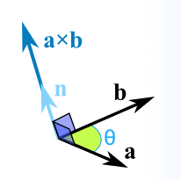
Cross Product
Cross product can be represented in
a × b = |a| |b| sin(θ) n
|a| is the magnitude (length) of vector a
|b| is the magnitude (length) of vector b
θ is the angle between a and b
n is the unit vector at right angles to both a and b

Slide 27
Quiz
Vector a has magnitude 3, vector b has magnitude 4, the angle between a and b is 30° and n is the unit vector at right angles to both a and b
What is a × b ? (leave answer in form of n)
a × b = |a| |b| sin(θ) n
= 3 * 4 sin(30º) n sin(30º) = 0.5(note in degree not radian)
= 12 * 0.5n
= 6n

